Slide 1
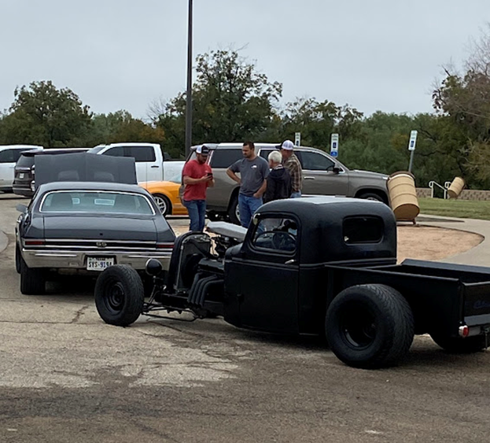

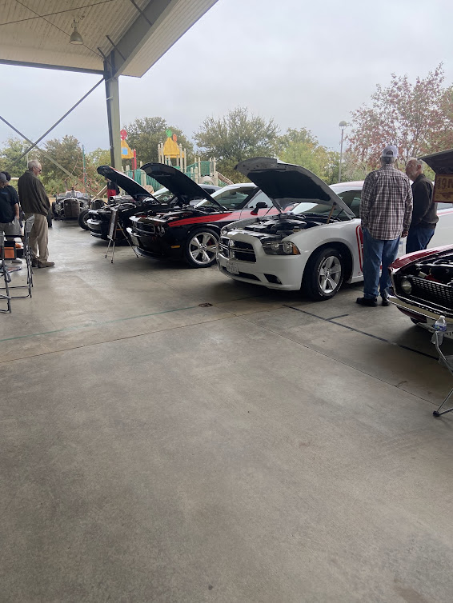
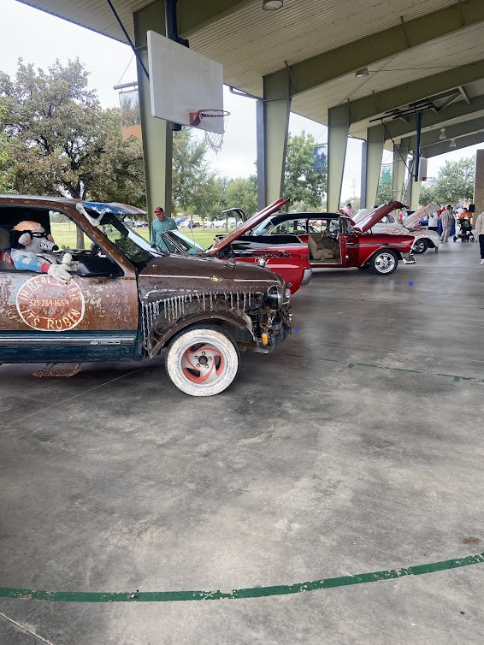

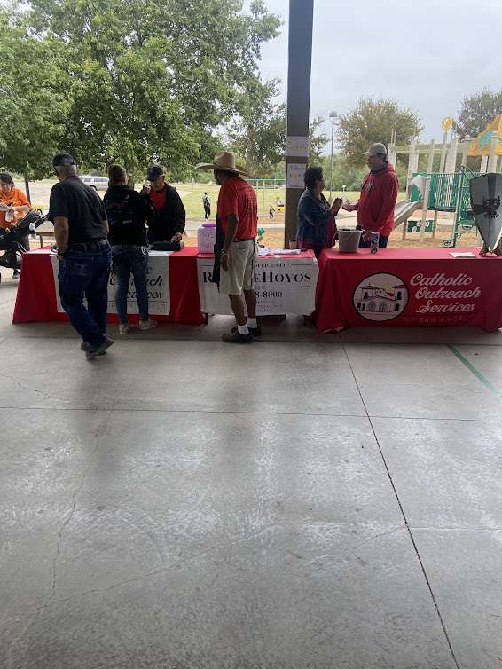
KNIGHTS OF COLUMBUS 2ND ANNUAL CAR SHOW FOR
CATHOLIC OUTREACH SERVICES
SEPTEMBER 2023

Slide 3
