Slide 1


Slide 2
Welcome to
Catholic Outreach Services
Sponsored by the six Catholic parishes in the San Angelo area & working in concert with local churches of various denominations and city social service agencies. Food, clothing and funding comes almost exclusively from parish support and private donations. Catholic Outreach depends on dedicated volunteers to keep its doors open.

Slide 3
HISTORY
  Catholic Charities organized in 1978 to help the poor and needy.
  Name changed to St. Vincent de Paul Society in 1989.
  Name changed to Catholic Outreach Services in 1996.
  Thrift store closed in November 2018.
  Reorganization and remodeling for opening in February 2021.
  New and expanded services.

Slide 4
Mission and Vision
Recognizing the uniqueness and dignity of each human being, Catholic Outreach Services seeks to alleviate suffering by empowering individuals to use the gifts God has given them. The goal is to help them live their lives to the best of their abilities in accordance with Matthew 25:35-40.

Slide 5
“I was hungry, and you gave me food,
I was thirsty and you gave me drink,
I was a stranger, and you welcomed me,
I was naked and you clothed me,
I was ill and you comforted me,
In prison and you came to visit me.
I assure you, as often as you did it
For one of my least ones, you did it for me.”
Matthew 25:35-40

Slide 6
New and Expanded Services
Sack lunches and hot meals
Food pantry bags 2x per month
Clothing, shoes, backpacks and bedding
Toiletries, towels, and shower passes to the YMCA
Rent, utilities, hotel, and medical & prescription assistance
Case management for homeless *

Slide 7
Greyhound and city bus passes
Gas charity
Cell phone assistance for homeless
Emergency disaster relief
Referrals to other agencies as needed
Immigration services
Pro-life ministry
Educational programs
Prison and jail ministry

Slide 8
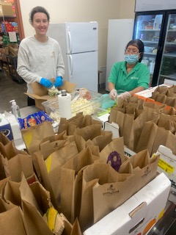
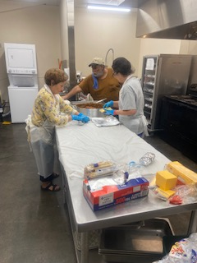
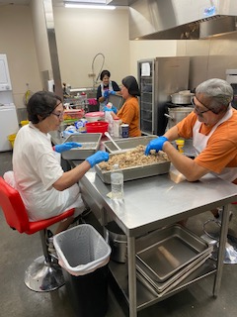
Sack Lunches and Hot Meals
***made from scratch nutritious meals***

Slide 9
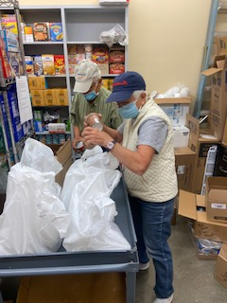
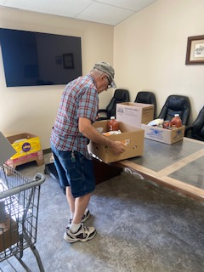
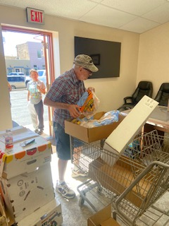
Food Pantry Bags

Slide 10
Month/Year | Meals Served | Food Bags | # Served by Bags
January | 3797 | 194 | 396
February | 3366 | 219 | 454
March | 3903 | 218 | 401
April | 3848 | 234 | 444
May | 3926 | 232 | 470
June | 4593 | 231 | 408
July | 4172 | 258 | 363
August | 4656 | 290 | 541
September | 3927 | 329 | 598
October | 4321 | 281 | 568
November | 3829 | 373 | 804
December | 3715 | 332 | 630
Total for 2023 | 48,053 | 3191 | 6077
Total for 2022 | 37,736 | 2036 | 4248

Slide 11
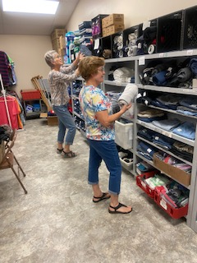
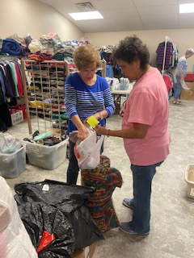
Shepherd’s Closet clothing, shoes, backpacks, bedding

Slide 12
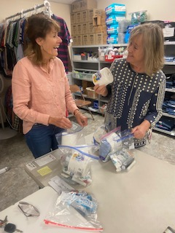
Toiletries, Towels, and Shower Passes to YMCA

Slide 13
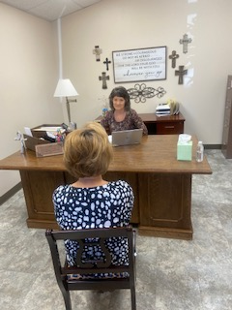
Rent, Utilities, Hotel, and Prescription Assistance
Transportation and Bus Passes
Referrals to Other Agencies
(requires appointment)

Slide 14

Educational Programs

Slide 15
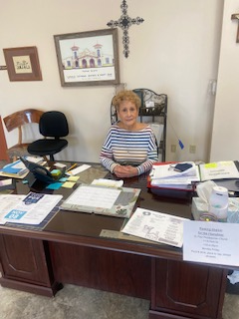
Immigration Services
(requires appointment with
Patricia Santana)

Slide 16
Pro Life Ministry
Coordinated by Stephanie Socha
To pray and serve to promote a “Culture of Life”
To provide materials to use in pro life events
Serves as a meeting place for pro life members
Promote programs and events concerning pro life
Present educational talks and prayer meetings
Anyone is invited to take part in this ministry

Slide 17
Numbers Served in 2023
48,053 meals
3,191 bags of food
6,077 individuals received bags of food
5,945 clients received direct charity
60,075 total individuals receiving services

Slide 18
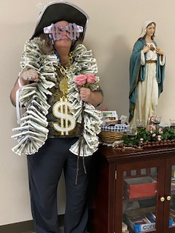
Sources of Funding
Monthly donations from local churches
Donations from individuals
Memorial and honorary donations
San Angelo Gives
Grant funding
More funds are needed as the number of people served continues to increase!

Slide 19
Donations of Items Needed
New and gently used men’s and women’s clothing, shoes, belts, and undergarments.
Backpacks, tote bags, sleeping bags, bedding, towels, washcloths
Nonperishable food, produce, eggs, sliced cheese, meat, chips, zipper bags, bottled water
Travel size hygiene-shampoo, soap, disposable razors, shaving cream, wipes, lotion, deodorant, hand sanitizer

Slide 20
Volunteers Needed!
Morning and afternoon food preparation.
Pantry organization
Food box distribution
Sort and organize Shepherd’s closet
Receptionist
Bookkeeping
Marketing and fundraising
Data entry

Slide 21
Hours of Operation
Catholic Outreach Services is open to the public 10:00am-2:00pm
Donations can be dropped off 10:00am-2:00pm
Volunteers in the kitchen are needed 9:00am-1:00pm and 4:00pm-7:00pm.
Thank you for considering donating your time, food, items and financial support!

